Slide 1
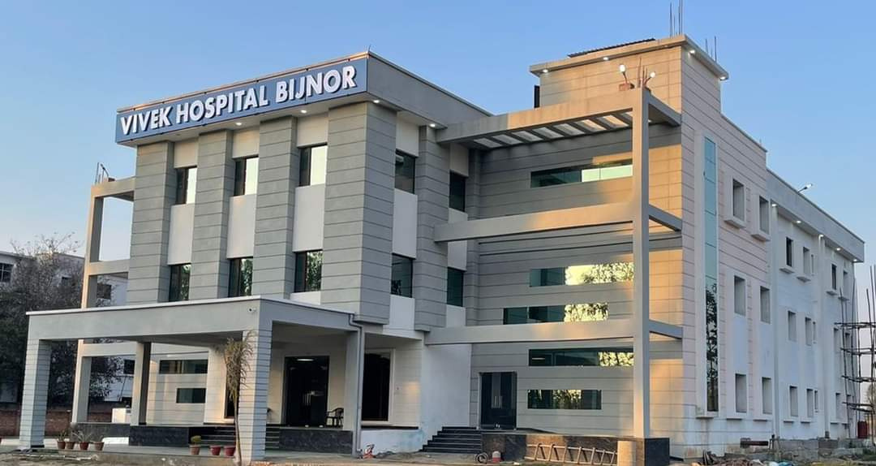


A square loyalty management
LOYALTY
PROGRAM
PROPOSAL
SERVICES,RESPECT,TRUST,SUPPORT, AND CONFIDENCE.

Slide 2
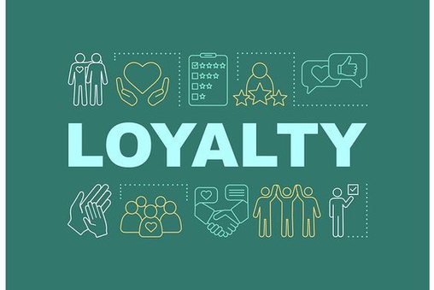
#01
LOYALTY IS GUARDING A CONFIDENCE
#02
LOYALTY IS KEEPING A PROMISE
#03
LOYALTY IS ABOUT VALUES
#04
LOYALTY IS COMMITMENT
#05
LOYALTY IS COVENANT
#06
LOYALTY IS KINDNESS

Slide 3
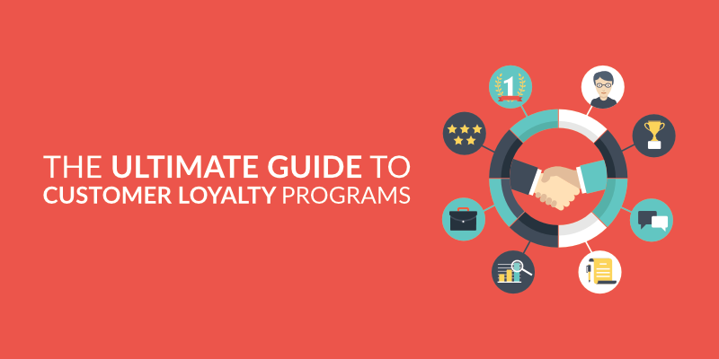
THE ULTIMATE GUIDE TO
CUSTOMER LOYALTY PROGRAMS

Slide 4
“Loyalty programs are structured marketing efforts that reward, and therefore encourage, loyal buying behavior — behavior which is potentially beneficial
to the firm.”
WHAT IS A CUSTOMER LOYALTY PROGRAM?
Businesses set up customer loyalty programs to give customers an extra reason to keep buying their product or service. The business will usually do this by offering a reward to customers who make repeat purchases.

Slide 5
What You Need in Order to Run Successful Loyalty Program?
Having a loyalty program on its own won’t turn one-time buyers into long-term customers. Your business will also have to provide an excellent product or service. A rewards program is merely an added extra on top of an already great business that can increase customer retention.
Additionally, loyalty programs won’t work for every business. You need to sell a product or (type of product) that customers buy regularly. While it can be a great idea for coffee shops, airlines, supermarkets, or hairdressers, it is likely to work less well for companies that sell fridges, for example.
Loyalty programs also aren’t always required for businesses to gain loyal customers. Google doesn’t offer a loyalty program, yet many people use their search engine numerous times a day because it offers such a great service. A rewards program would be unlikely to change this much.

Slide 6
TIPS Before Implementing a Loyalty Program
    The reward you give away
    Your brand positioning
    Your product
    The Type of Program you will Use
    Make the loyalty reward attractive
    Relationship management to quickly reward loyal customer

Slide 7

How loyalty program is beneficial for your business?
    Reward current customer
    Boost profits
    Finds new client
    Improve brand reputation
    Get ahead of competitiors

Slide 8
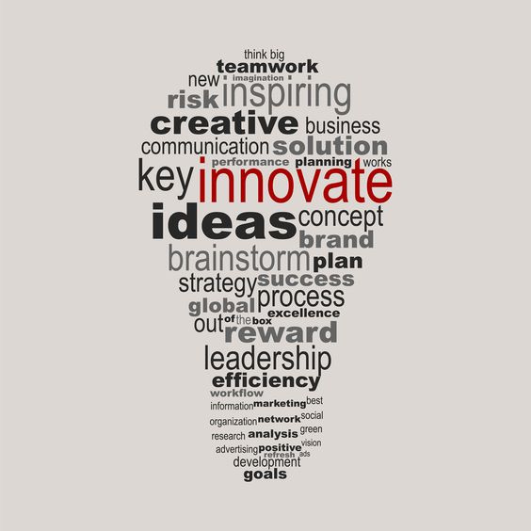
BEST PROGRAM STRUCTURES
BRANDING AND PROMOTIONS
Brand marketing strategy is a long-term plan whose purpose is to increase a brand's position and positive perception in the market.

Slide 9
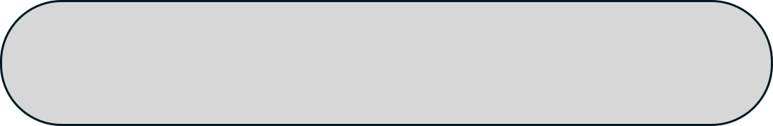


TELECOMMUNICATION
Information
Generation
Telecommunication
Interest
A telecommunication loyalty program is a customer retention tool that helps organizations keep their customers by providing hyper-relevant rewards, benefits, extra services, and, quite often, partner deals.

Slide 10

SERVICES
Services which is given by the respective antity to the customer or clients are the key point of the loyalty program.
Services are the bridge between the antity and their customers.
Services are the commitment by us or the respective antity to the customer and also the base of the loyalty program.

Slide 11
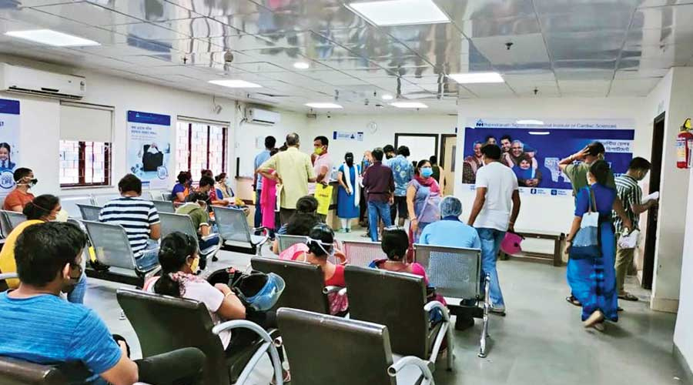
INCREMENT IN FOOTFALL
Footfall can be considered as a number of people's visit in a particular time .
Footfall in an important indicator of how successful a company's advertising is at bringing customer into the respective antity.

Slide 12

POINTS FROM OUR SIDE
    AVERAGE TENURE TIME – 6 MONTHS.
    WE GENERATE 300 CALLS PER DAY.
    IN 6 MONTHS THE AVERAGE COUNT OF CALLS WILL BE 54000-60000.
    TOTAL NUMBERS OF MEMBERSHIP 500 IN 6 MONTHS.
    IN ONE MEMBERSHIP 10 MEMBERS WILL BE ENROLL SO 5,000 PEOPLES WILL CONNECTED TO YOU IN 6 MONTHS.
    WE HAVE 5 DIALERS AND 1 DELIVERY EXECUTIVE IN OUR TEAM.

Slide 13

WRAPPING UP
As you'll have seen in this
We created a suitable customer loyalty program for you that is exactly suited your business type.
This customer loyalty program can be as simple or as complex according to your choice.. It will helps you to grow your business and gaves you new strategies to promote your business and forward a increment in your daily basis footfall.
We hope you considered this customer loyalty program as a beneficial step for your business.
Hopefully
You like the way of presenting of our customer loyalty program proposal to you.

Slide 14
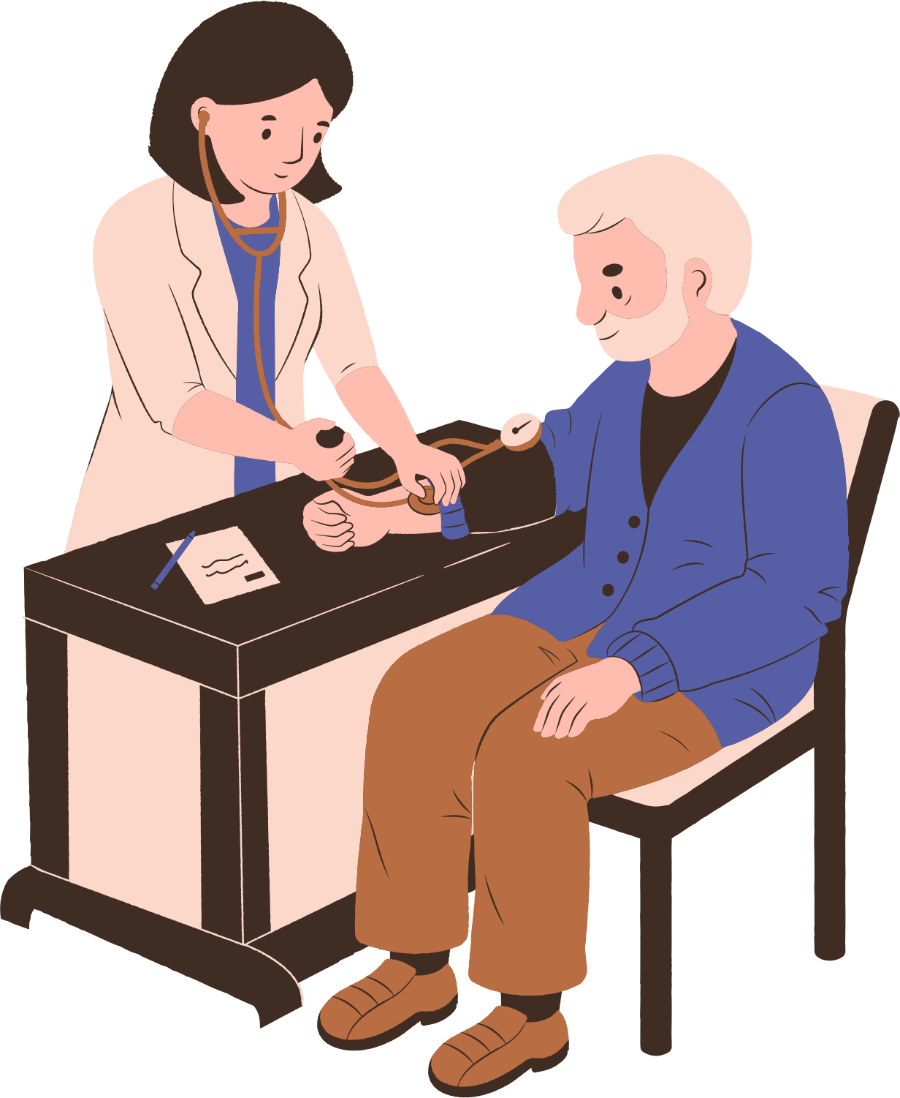
Our step to promote hospitals in public
Once we start working with Hospital then it is our responsibility to promote servies and acknowledgment of hospital to the publice in a precise manner .
Our first step regarding this is generating camps with hospital in school ,college, industries And different location in the city.

Slide 15
Thank you!

